Slide 1
Forests

Slide 2
Outline
This topic covers Prim’s algorithm:
Finding a minimum spanning tree
The idea and the algorithm
An example

Slide 3
Hierarchical relation
Recall the properties of a hierarchical relation:
It is never true that x ≺ x
If x ≺ y then y ⊀ x
If x ≺ y and y ≺ z, it follows that x ≺ z
There is a root r such that r ≺ x for all x
If is x ≺ z and y ≺ z, it follows that either x ≺ y, x = y or x ≻ y
If we remove the restriction that there is a unique root r, we allow for the possibility of a number of roots
If a set S has such a relationship on it, we can define a tree rooted at a point x as the collection of all y such that x ≺ y
For a finite set S, there is a set of points R such that for each r ∈ R, there are no points x ∈ S such that x ≺ r
We call R the set of roots

Slide 4
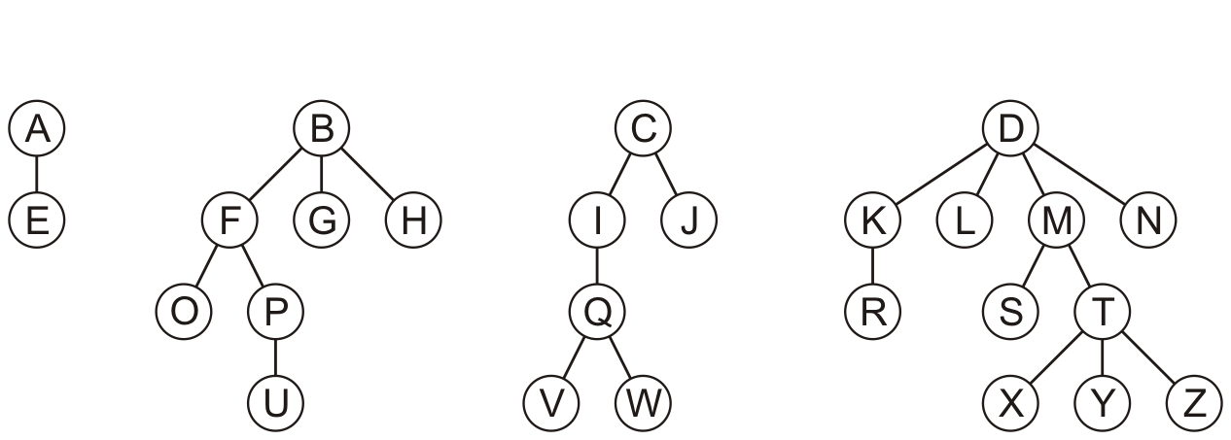
Definition
A rooted forest is a data structure that is a collection of disjoint rooted trees
A forest can be used to store the previously described relation

Slide 5
Definition
Note that:
Any tree can be converted into a forest by removing the root node
Any forest can be converted into a tree by adding a root node that has the roots of all the trees in the forest as children

Slide 6
Traversals
Traversals on forests can be achieved by treating the roots as children of a notional root
v_{k + 1}
e_{k}

Slide 7
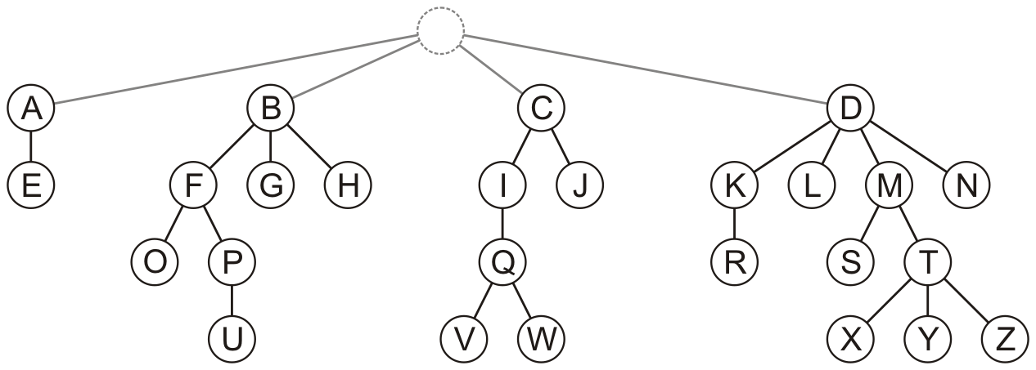
Traversals
Traversals on forests can be achieved by treating the roots as children of a notional root
Pre-order traversal: A E B O F P U G H C I Q V W J D K R L M S T X Y Z N
Post-order traversal: E A O U P F G H B V W Q I J C R K L S X Y Z T M N D
Breadth-first traversal: A B C D E F G H I J K L M N O P Q R S T U V W X Y Z
v_{k + 1}
e_{k}

Slide 8
Implementation
Using the Simple_tree structure, one could simply keep a linked list of trees
Single_list<Simple_tree *> list;
Using the parental tree structure, one could remove the restriction that only one entry stores itself
0 | 1 | 2 | 3 | 4 | 5 | 6 | 7 | 8 | 9 | 10 | 11 | 12 | 13 | 14 | 15 | 16 | 17 | 18 | 19 | 20 | 21 | 22 | 23 | 24 | 25
0 | 1 | 2 | 3 | 0 | 1 | 1 | 1 | 2 | 2 | 3 | 3 | 3 | 3 | 5 | 5 | 6 | 10 | 12 | 12 | 15 | 16 | 16 | 19 | 19 | 19
A | B | C | D | E | F | G | H | I | J | K | L | M | N | O | P | Q | R | S | T | U | V | W | X | Y | Z

Slide 9

Application
In Windows, each drive forms the root of its own directory structure
Each of the directories is hierarchical—that is, a rooted tree

Slide 10
Application
In C++, if you do not use multiple inheritance, the class inheritance structure is a forest
In Java and C#, it is a rooted tree with Object being the root class
If you allow multiple inheritance in C++, you have a partial order
A directed acyclic graph data structure allows you store such a relation

Slide 11
Looking ahead
We will revisit forests with
The disjoint set data structure
Graph theory

Slide 12
Summary
In this topic, we defined a forest
A collection of rooted trees
One less restriction than a hierarchical order
One more restriction than partial orders
Traversals can be defined on forests
Considered two implementations:
Linked list of simple trees
A parental tree implementation
Represents the Windows concept of drives

Slide 13
References
Wikipedia, http://en.wikipedia.org/wiki/Tree_(graph_theory)#forest
These slides are provided for the ECE 250 Algorithms and Data Structures course. The material in it reflects Douglas W. Harder’s best judgment in light of the information available to him at the time of preparation. Any reliance on these course slides by any party for any other purpose are the responsibility of such parties. Douglas W. Harder accepts no responsibility for damages, if any, suffered by any party as a result of decisions made or actions based on these course slides for any other purpose than that for which it was intended.

